Slide 1
Introduction To Machine Learning
Presented by: Tan Li Tung

Slide 2

Overview
Introduction
Applications of Machine Learning
Types of Machine Learning
Regression vs Classification Problem
Train, Validation, Test Dataset
Supervised Machine Learning Workflow

Slide 3

What is Machine Learning?
Machine learning is a method used to iteratively learn from data without being explicitly programmed by humans
It allow computers to discover hidden and useful insights

Slide 4
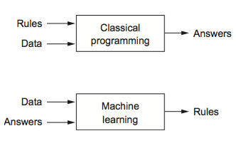
The New Program Paradigm

Slide 5
When to Use Machine Learning?
A pattern exists
We cannot pin down the pattern mathematically
We have data and hopefully LOTS of data

Slide 6

Applications of Machine Learning
Products recommendations
Fraud detection
Email spam filtering
Customer segmentation
Maps
Image recognition
Search engine
Financial market analysis
And a lot more!

Slide 7
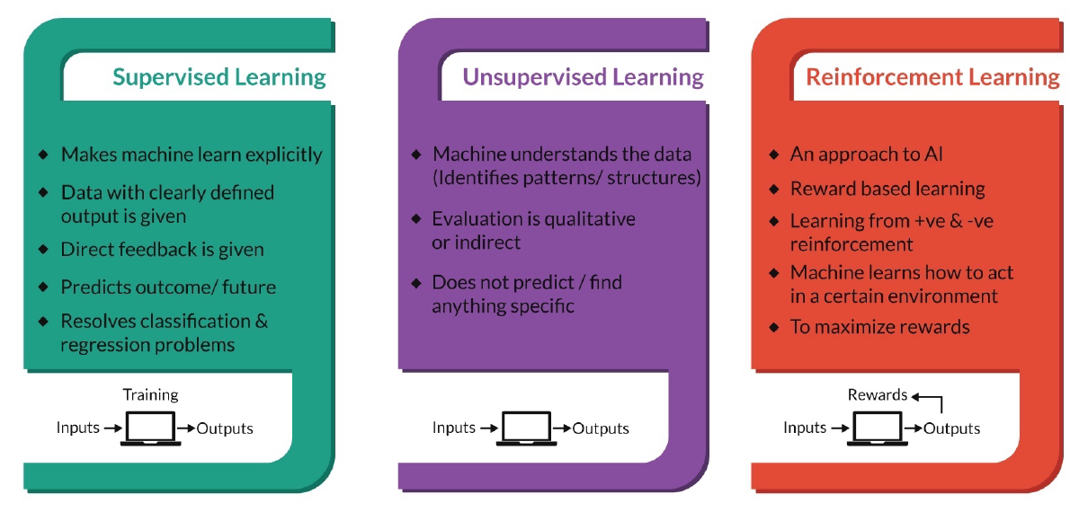
Supervised Learning
Makes machine learn explicitly
Data with clear defined output is given
Direct feedback is given
Predicts outcome/ future
Resolve classification and regression problem

Slide 8
Features
Target
PassengerId | Pclass | Name | Sex | Age | SibSp | Parch | Ticket | Fare | Cabin | Embarked | Survived
1 | 3 | Braund, Mr. Owen Harris | male | 22 | 1 | 0 | A/5 21171 | 7.25 |  | S | 0
2 | 1 | Cumings, Mrs. John Bradley (Florence Briggs Thayer) | female | 38 | 1 | 0 | PC 17599 | 71.2833 | C85 | C | 1
3 | 3 | Heikkinen, Miss. Laina | female | 26 | 0 | 0 | STON/O2. 3101282 | 7.925 |  | S | 1
4 | 1 | Futrelle, Mrs. Jacques Heath (Lily May Peel) | female | 35 | 1 | 0 | 113803 | 53.1 | C123 | S | 1
5 | 3 | Allen, Mr. William Henry | male | 35 | 0 | 0 | 373450 | 8.05 |  | S | 0
6 | 3 | Moran, Mr. James | male |  | 0 | 0 | 330877 | 8.4583 |  | Q | 0
7 | 1 | McCarthy, Mr. Timothy J | male | 54 | 0 | 0 | 17463 | 51.8625 | E46 | S | 0
8 | 3 | Palsson, Master. Gosta Leonard | male | 2 | 3 | 1 | 349909 | 21.075 |  | S | 0
9 | 3 | Johnson, Mrs. Oscar W (Elisabeth Vilhelmina Berg) | female | 27 | 0 | 2 | 347742 | 11.1333 |  | S | 1

Slide 9
Unsupervised Learning
Machine understand the data (identifies patterns/ structures)
Evaluation is qualitative or indirect
Does not predict or find anything specific

Slide 10
InvoiceNo | StockCode | Description | Quantity | InvoiceDate | UnitPrice | CustomerID | Country
536365 | 85123A | WHITE HANGING HEART T-LIGHT HOLDER | 6 | 12/1/2010 8:26 | 2.55 | 17850 | United Kingdom
536365 | 71053 | WHITE METAL LANTERN | 6 | 12/1/2010 8:26 | 3.39 | 17850 | United Kingdom
536365 | 84406B | CREAM CUPID HEARTS COAT HANGER | 8 | 12/1/2010 8:26 | 2.75 | 17850 | United Kingdom
536370 | 22728 | ALARM CLOCK BAKELIKE PINK | 24 | 12/1/2010 8:45 | 3.75 | 12583 | France
536370 | 22727 | ALARM CLOCK BAKELIKE RED | 24 | 12/1/2010 8:45 | 3.75 | 12583 | France
536370 | 22726 | ALARM CLOCK BAKELIKE GREEN | 12 | 12/1/2010 8:45 | 3.75 | 12583 | France
536370 | 21724 | PANDA AND BUNNIES STICKER SHEET | 12 | 12/1/2010 8:45 | 0.85 | 12583 | France
536370 | 21883 | STARS GIFT TAPE | 24 | 12/1/2010 8:45 | 0.65 | 12583 | France
536370 | 10002 | INFLATABLE POLITICAL GLOBE | 48 | 12/1/2010 8:45 | 0.85 | 12583 | France

Slide 11
Reinforcement Learning
An approach to AI
Reward based learning
Learn from positive and negative reinforcement
Machine learns how to act in certain environment
To maximize reward or minimize punishment

Slide 12
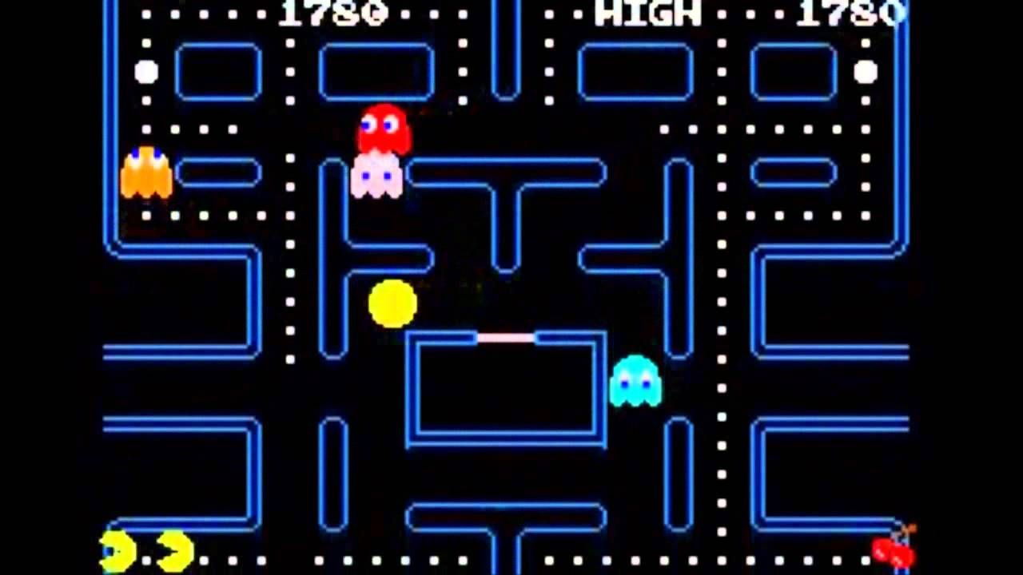

Slide 13
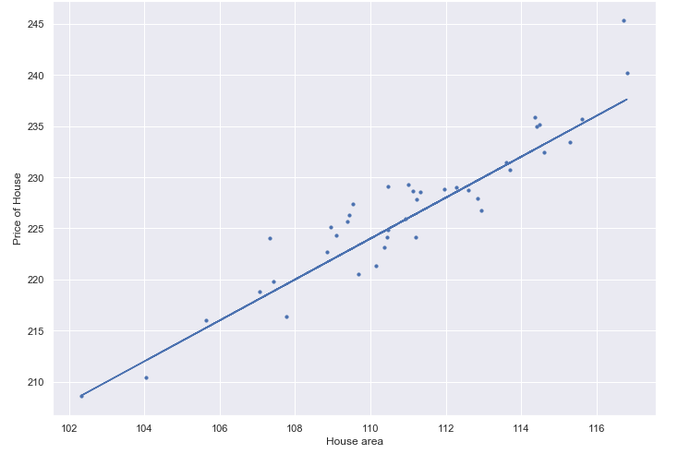
Linear Regression
Feature | Area of house
Label | Price of house
Goal/ Aim | We want to predict the price of a house from the given area
Notes:
We will only focus on supervised and unsupervised learning algorithms

Slide 14
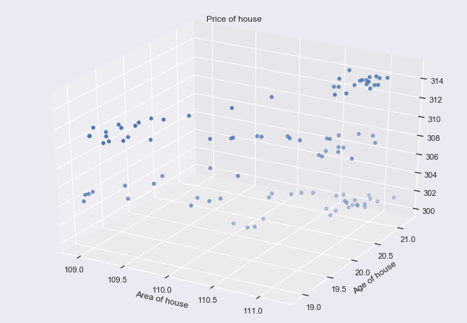
Multiple Linear Regression
Feature | Area of house, Age of house
Label | Price of house
Goal/ Aim | We want to predict the price of a house from the given area and age of house
Notes:
We will only focus on supervised and unsupervised learning algorithms

Slide 15
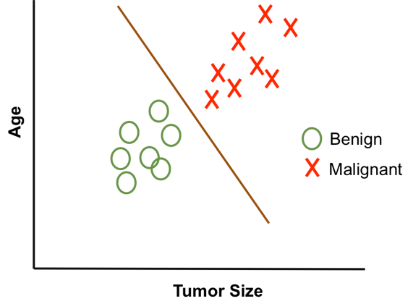
Classification
Feature | Tumor Age and Tumor Size
Label | Tumor (Benign or Malignant)
Goal/ Aim | We want to predict whether a tumor is benign or malignant from the given age and tumor size
Notes:
We will only focus on supervised and unsupervised learning algorithms

Slide 16



Train, Validation and Test Dataset
Learn
(Train)
Practice by doing Exercise
(Validate)
Take Exam
(Test)
Notes:
We will only focus on supervised and unsupervised learning algorithms

Slide 17
Train, Validation and Test Dataset
Learn
(Train)
Practice by doing Exercise
(Validate)
Take Exam
(Test)
Notes:
We will only focus on supervised and unsupervised learning algorithms

Slide 18
Train, Validation and Test Dataset
Learn
(Train)
Practice by doing Exercise
(Validate)
Take Exam
(Test)
Notes:
We will only focus on supervised and unsupervised learning algorithms

Slide 19
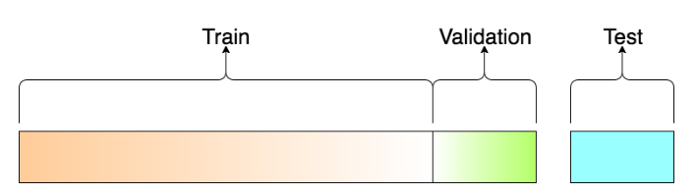
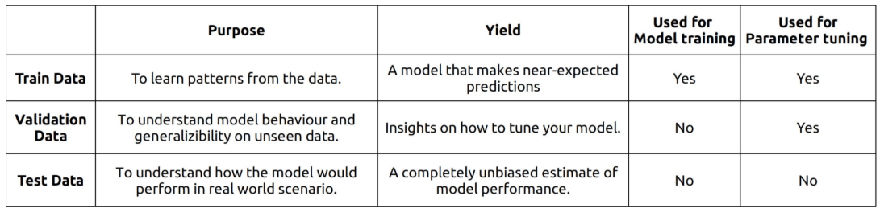
Train, Validation and Test Dataset
Notes:
We will only focus on supervised and unsupervised learning algorithms

Slide 20
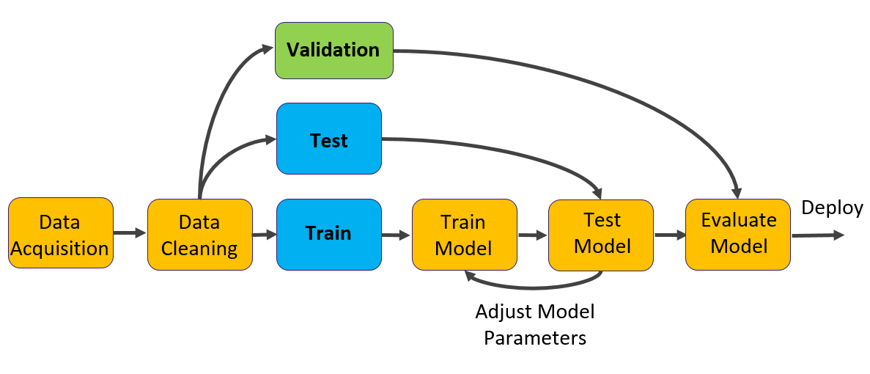
Supervised Machine Learning Workflow
Test
Validate
Notes:
We will only focus on supervised and unsupervised learning algorithms

Slide 21
Hands on!

Slide 22



Normalization and Standardization
Normalization
Scale the numeric values in between the range of 0 and 1.
Standardization
Scale the numeric values such that it have a mean of 0 and variance of 1.

Slide 23

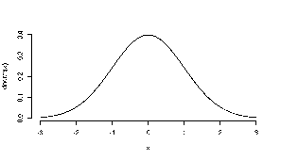
When to Normalize and Standardize?
Generally (but not limited to):
Normalization is used when data is not Gaussian distributed.
Standardization, on the other hand, is used when the data follows a Gaussian distribution.

Slide 24
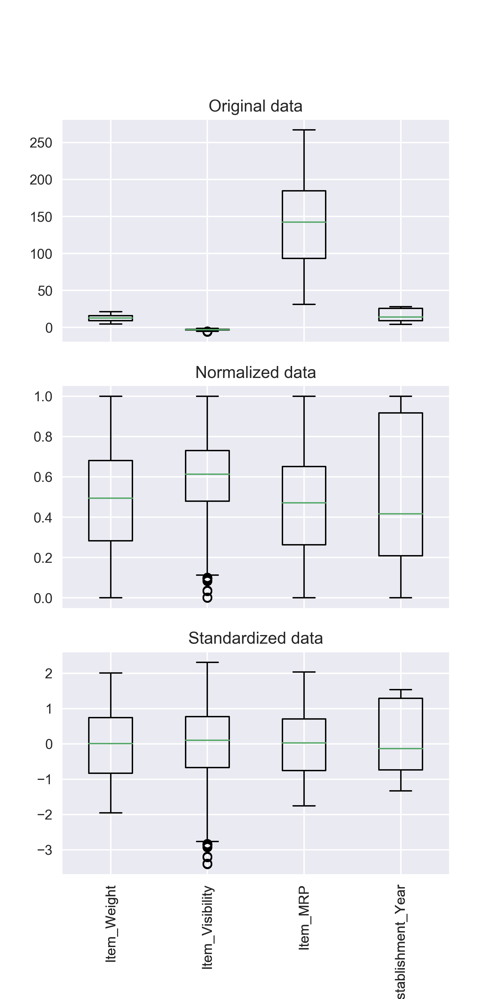
When to Normalize and Standardize?
You can always fit your model with raw, normalized and standardized data then compare the performance to obtain the best outcome!

Slide 25
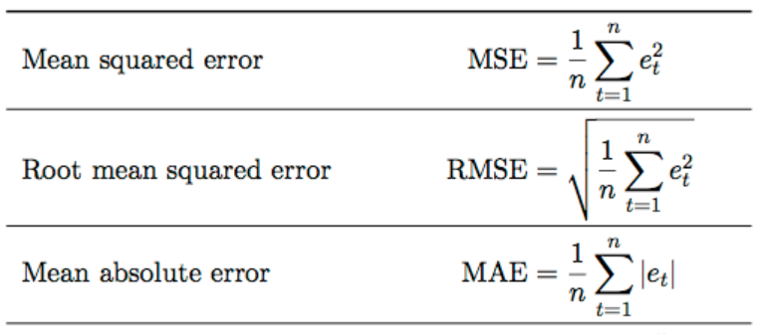
Metrices for Model Evaluation (Regression)
Notes:
We will only focus on supervised and unsupervised learning algorithms

Slide 26
Questions?

Slide 27
Thank you

